Slide 1
Introduction of Reinforcement Learning
Yifei Huang

Slide 2
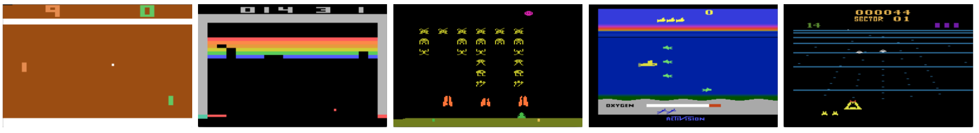
Computer can play game
Pong
Break Out
Sea Quest
Beam Rider
2013, DeepMind, https://arxiv.org/abs/1312.5602

Slide 3
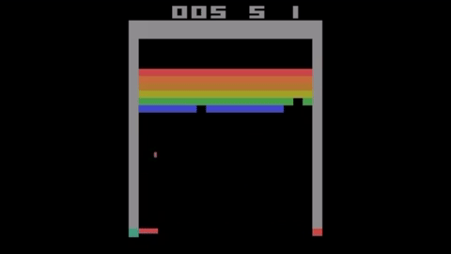
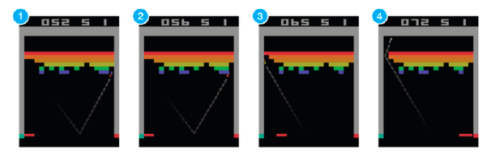
How to teach the machine to play a game?
Example: breakout (one of the Atari games)
Suppose you want to teach an agent (e.g., NN) to play this game
Supervised training (expert players play a million times) that’s not how we learn!
Reinforcement Learning
Result of training for 24 hours using GTX 980 ti.
https://github.com/devsisters/DQN-tensorflow

Slide 4
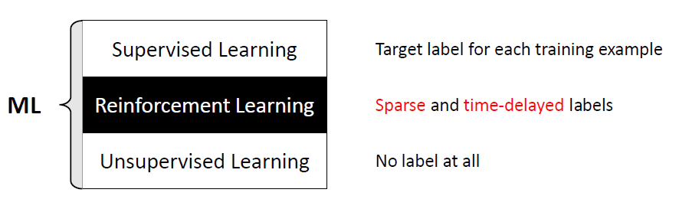
Supervised learning VS reinforcement learning VS unsupervised learning

Slide 5
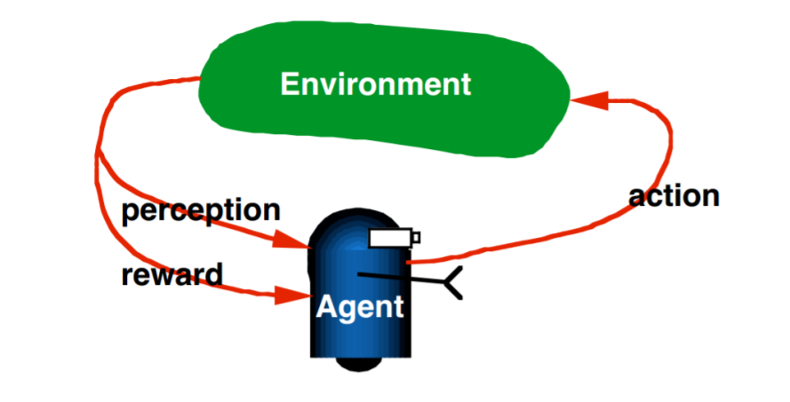
RL is learning from iteration
http://www.teach.cs.toronto.edu/~csc2542h/fall/material/csc2542f16_dqn.pdf

Slide 6
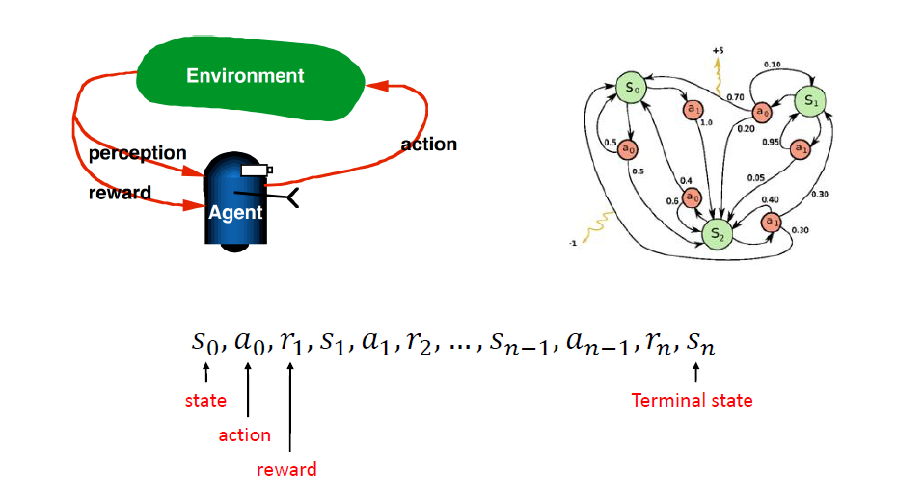
Markov Decision Process

Slide 7
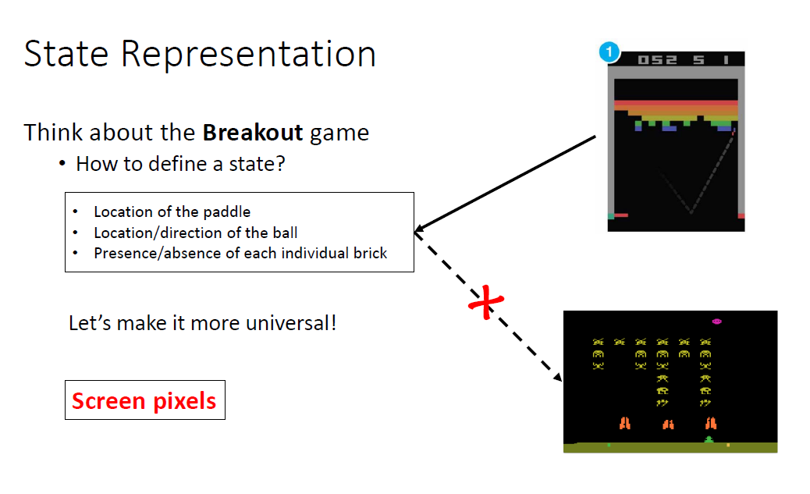
How to define a state
Universal Artificial Intelligence

Slide 8
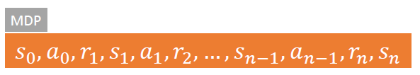
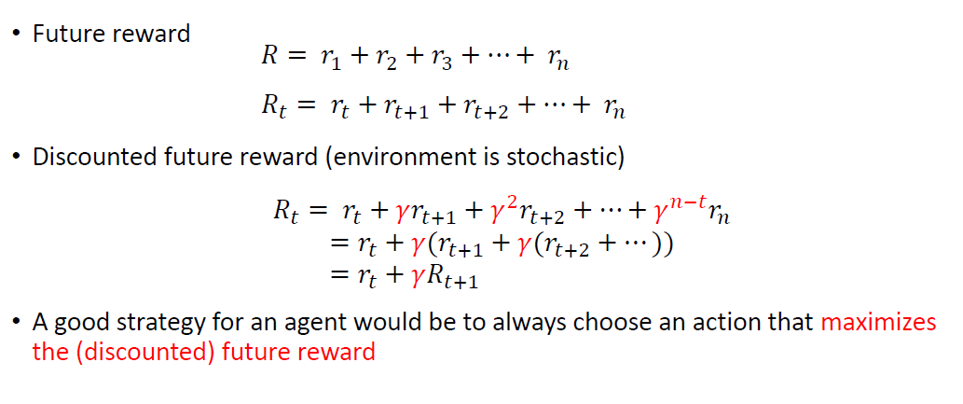
How to define a reward?

Slide 9
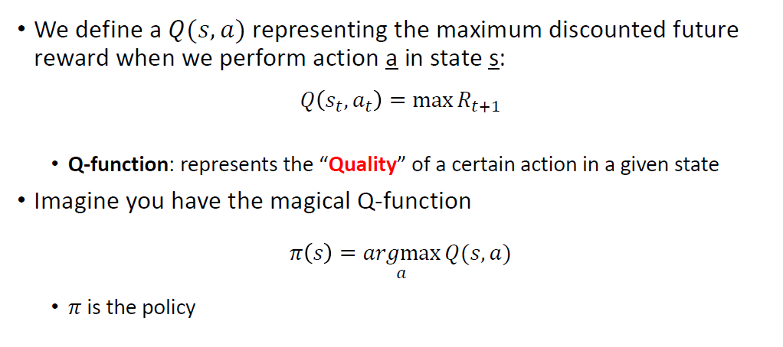
How to define an action?

Slide 10
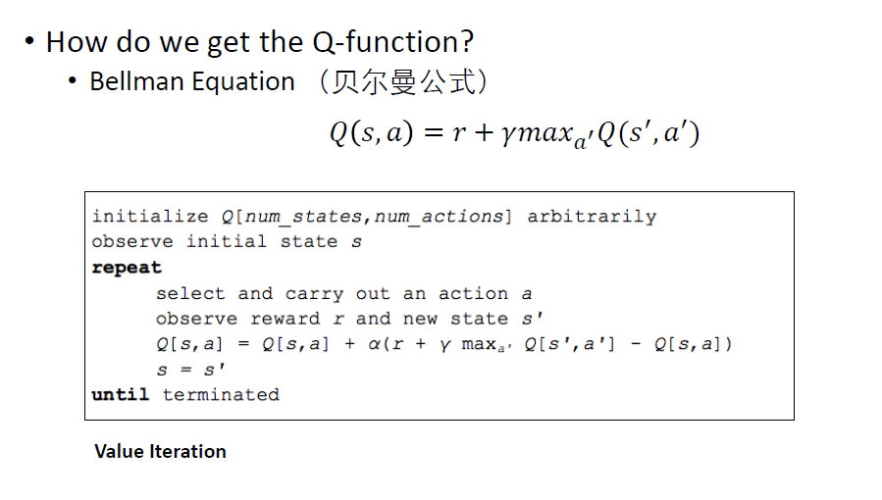
Q Learning and BellMan Equation

Slide 11


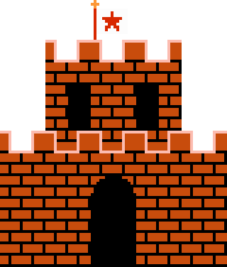
Q-Table Learning
R-table
Q-table
 | left | up | right | down
1 | X | X | 0 | -100
2 | 0 | X | 0 | 0
3 | 0 | X | -100 | 0
4 | X | X | X | X
5 | X | X | X | X
6 | X | 0 | 0 | 0
7 | 0 | 0 | 0 | -100
8 | 0 | -100 | X | 0
9 | X | -100 | 0 | -100
10 | 0 | 0 | -100 | 0
11 | X | X | X | X
12 | -100 | 0 | X | 100
13 | X | X | X | X
14 | -100 | 0 | 0 | X
15 | 0 | -100 | 100 | X
16 | X | X | X | X
 | left | up | down | right
1 | 0 | 0 | 0 | 0
2 | 0 | 0 | 0 | 0
3 | 0 | 0 | 0 | 0
4 | 0 | 0 | 0 | 0
5 | 0 | 0 | 0 | 0
6 | 0 | 0 | 0 | 0
7 | 0 | 0 | 0 | 0
8 | 0 | 0 | 0 | 0
9 | 0 | 0 | 0 | 0
10 | 0 | 0 | 0 | 0
11 | 0 | 0 | 0 | 0
12 | 0 | 0 | 0 | 0
13 | 0 | 0 | 0 | 0
14 | 0 | 0 | 0 | 0
15 | 0 | 0 | 0 | 0
16 | 0 | 0 | 0 | 0
1 | 2 | 3 | 4
5 | 6 | 7 | 8
9 | 10 | 11 | 12
13 | 14 | 15 | 16
-100
0
+100

Slide 12
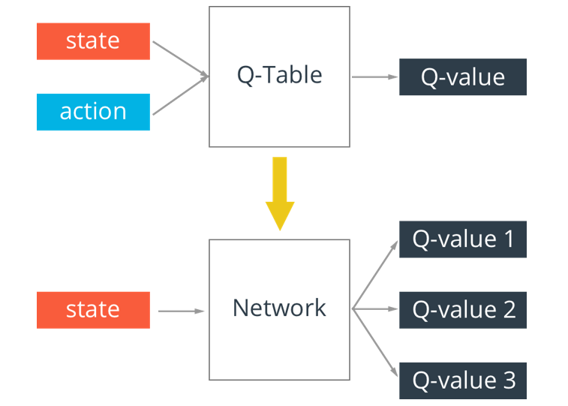
From Q-Table Learning to Deep Q-Learning

Slide 13
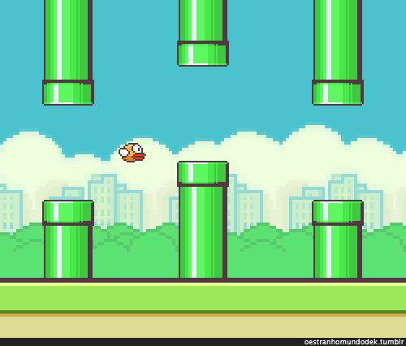
Using DQN to Play Game Flappy Bird
https://github.com/yenchenlin/DeepLearningFlappyBird

Slide 14
